Slide 1
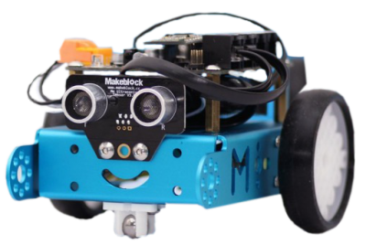
Intro to mBots
MODULE 3

Slide 2
1.
Setup
Connecting mBots to the computers

Slide 3
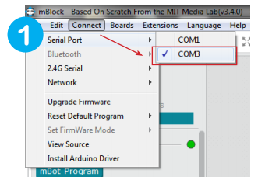
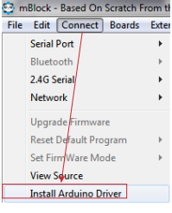
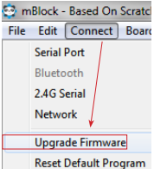
Plug in the mBot cable to the computer and turn on the mBot
Can’t see the serial port?

Slide 4
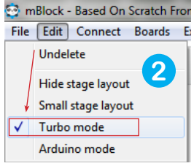
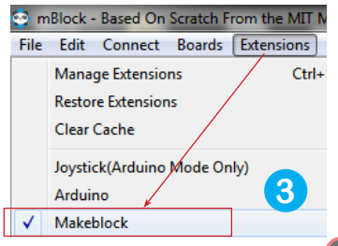
Rest of the steps:

Slide 5
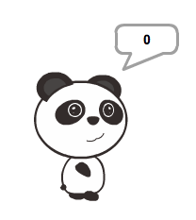

Testing
Play a tone,
Measure the distance to an obstacle
What is the sensor that can tell me the distance to an obstacle?
Make panda (or your chosen) sprite display the distance to an obstacle
What is a block we can use?

Slide 6
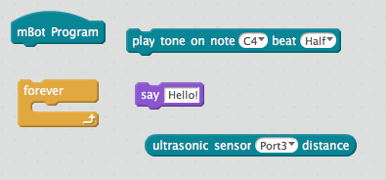
Testing
Play tone,
Show distance to an obstacle

Slide 7
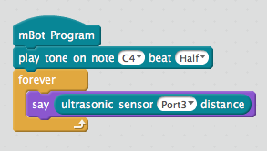
Testing
Play tone,
Show distance to an obstacle (tip* use ultrasonic sensor)

Slide 8
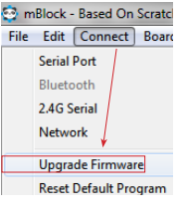
Still not working?
Upgrade the firmware and try again
*make sure the upload has finished before running the test code again
Break

Slide 9

Break time

Slide 10
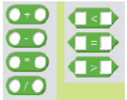
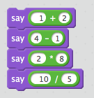
OPERATORS
Four operations include
addition,
subtraction,
multiplication,
division.

Slide 11
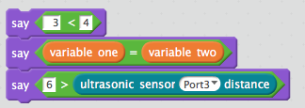

OPERATORS
Four operations include
addition,
subtraction,
multiplication,
division.
Comparison operators can be used to compare
the value with the variable**,
the variable with the variable**,
the value with the value.
**the input of the sensor can also be used as a variable

Slide 12
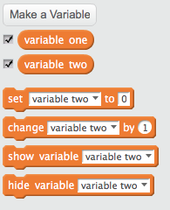
VARIABLES
Variable is a container for storing data.
Its value can be freely modified according to the needs.

Slide 13
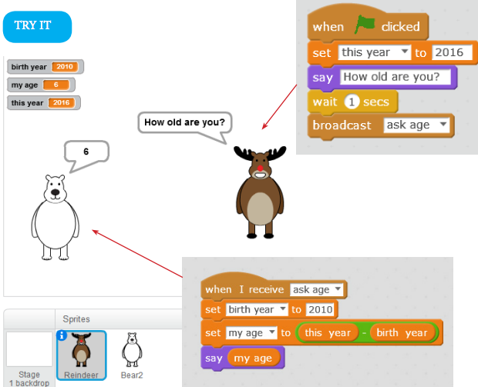
Exercise

Slide 14

If Then Block
If Then is what’s called a conditional statement in programming. The program queries if one condition exists, then it commands it to do something

Slide 15
If Then Game
For every round, there is one Programmer and everyone else is a Computer.
If I ____ (fill in the blank), then you _____ (fill in the blank).
For example
“If I turn in a circle, Then you turn in a circle.”

Slide 16

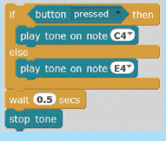
If Then else Blocks
The “if .. then otherwise block” is a double branch structure. The upper part will run if the conditions are met. If not, the lower part will run.

Slide 17
If Then ELSE Game
For every round, there is one Programmer and everyone else is a Computer.
If I ____ (fill in the blank), then you _____ (fill in the blank).
For example
“If I raise my right arm, Then you raise your left arm, Else raise your right foot.”

Slide 18
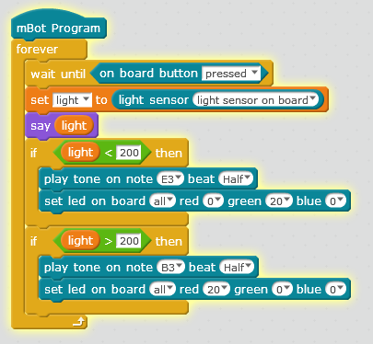
Try it
Run the program and see what it does.
Can you rewrite the two if blocks to if then else block?

Slide 19
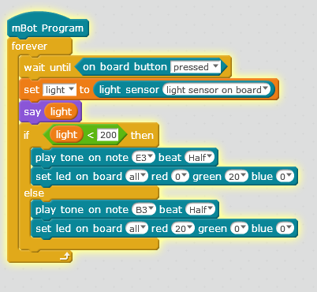
Try it

